Slide 1

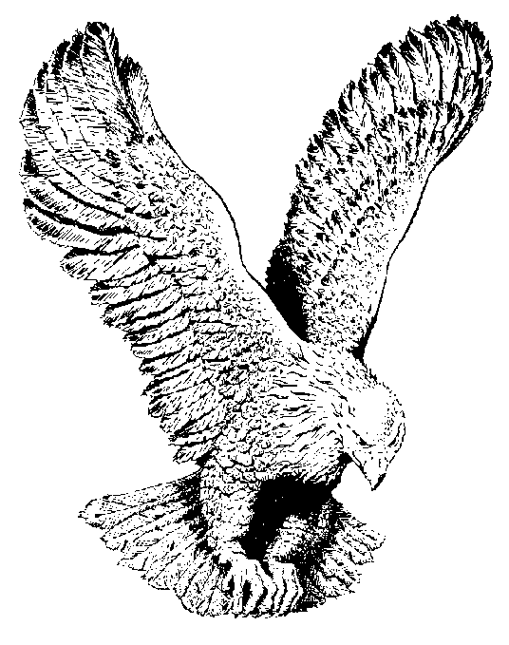
592 THE LIFTER OF MY HEAD
My glory and the lifter of my head
My glory and the lifter of my head
For Thou O Lord art a shield to me
My glory and the lifter of my head.

Slide 2
I cried unto the Lord with my voice
I cried unto the Lord with my voice
And He heard me out of His holy hill…

